Slide 1
LARC Recommended 2 Meter / 70 Centimeter Radios and Auxiliary Equipment
We do not recommend that you buy used equipment
Copyright LARC 09/2022

Slide 2
LARC Recommended 2 Meter / 70 Centimeter Radios and Auxiliary Equipment
We do not recommend that you buy used equipment
We do recommend that you purchase your equipment from an established and reputable company i.e. no e-bay
Copyright LARC 09/2022

Slide 3
LARC Recommended 2 Meter / 70 Centimeter Radios and Auxiliary Equipment
We do not recommend that you buy used equipment
We do recommend that you purchase your equipment from an established and reputable company i.e. no e-bay
This presentation does show web pages from various companies including the listed prices for equipment we are recommending. This is not meant to endorse the company, but to give you an approximation of the price you can expect pay for the given item.
Copyright LARC 09/2022

Slide 4
LARC Recommended 2 Meter / 70 Centimeter Radios and Auxiliary Equipment
To qualify for this list items had to:
Currently be in production and available for purchase
We will not recommend any equipment that is no longer manufactured
Copyright LARC 09/2022

Slide 5
LARC Recommended 2 Meter / 70 Centimeter Radios and Auxiliary Equipment
To qualify for this list items had to:
Currently be in production and available for purchase
We will not recommend any equipment that is no longer manufactured
Be highly rated by hams (e-ham.net)
Copyright LARC 09/2022

Slide 6
LARC Recommended 2 Meter / 70 Centimeter Radios and Auxiliary Equipment
To qualify for this list items had to:
Currently be in production and available for purchase
We will not recommend any equipment that is no longer manufactured
Be highly rated by hams (e-ham.net)
Approved by
Bryan Leavitt W0BCL
James Nelson W0JRN
Copyright LARC 09/2022

Slide 7
LARC Recommended 2 Meter / 70 Centimeter Radios and Auxiliary Equipment
Review HT’s at 3 different levels
Basic
Intermediate
Advanced
Copyright LARC 09/2022

Slide 8
LARC Recommended 2 Meter / 70 Centimeter Radios and Auxiliary Equipment
Review HT’s at 3 different levels
Basic
Intermediate
Advanced
Review Base/Mobile units at 4 different levels
Single band
Basic
Intermediate
Advanced
Copyright LARC 09/2022

Slide 9
LARC Recommended 2 Meter / 70 Centimeter Radios and Auxiliary Equipment
Review HT’s at 3 different levels
Basic
Intermediate
Advanced
Review Base/Mobile units at 4 different levels
Single band
Basic
Intermediate
Advanced
Briefly look at recommended
Antennas and mount
Coax
Surge suppression
Power Supply
Copyright LARC 09/2022

Slide 10
LARC Recommended 2 Meter / 70 Centimeter Radios and Auxiliary Equipment
Features
Dual Band
Able to transmit/receive in both 2 m and 70 cm bands
Copyright LARC 09/2022

Slide 11
LARC Recommended 2 Meter / 70 Centimeter Radios and Auxiliary Equipment
Features
Dual Band
Able to transmit/receive in both 2 m and 70 cm bands
Dual Receive
Simultaneous receive on two different frequencies
V/V, V/U, U/V, U/U
Copyright LARC 09/2022

Slide 12
LARC Recommended 2 Meter / 70 Centimeter Radios and Auxiliary Equipment
Features
Dual Band
Able to transmit/receive in both 2 m and 70 cm bands
Dual Receive
Simultaneous receive on two different frequencies
V/V, V/U, U/V, U/U
APRS
Automatic Packet Reporting System
Transmits/Receives current position and other information
Requires GPS
144.39 mHz in North America
Copyright LARC 09/2022

Slide 13
LARC Recommended 2 Meter / 70 Centimeter Radios and Auxiliary Equipment
Features
Dual Band
Able to transmit/receive in both 2 m and 70 cm bands
Dual Receive
Simultaneous receive on two different frequencies
V/V, V/U, U/V, U/U
APRS
Automatic Packet Reporting System
Transmits/Receives current position and other information
Requires GPS
144.39 mHz in North America
Cross Band Repeat
Allows the unit to be used as temporary repeater
Input/Output are usually on separate bands
Copyright LARC 09/2022

Slide 14
LARC Recommended 2 Meter / 70 Centimeter Radios and Auxiliary Equipment
MODES
Analog
Supported by all manufacturers and virtually all radios
Wide (25 kHz) and narrow FM (12.5) kHz)
Copyright LARC 09/2022

Slide 15
LARC Recommended 2 Meter / 70 Centimeter Radios and Auxiliary Equipment
MODES
Analog
Supported by all manufacturers and virtually all radios
Wide (25 kHz) and narrow FM (12.5) kHz)
D-Star (Digital Smart Technologies for Amateur Radio)
Developed in Japan
Supported mostly by ICOM
Not gaining wide acceptance
Copyright LARC 09/2022

Slide 16
LARC Recommended 2 Meter / 70 Centimeter Radios and Auxiliary Equipment
MODES
Analog
Supported by all manufacturers and virtually all radios
Wide (25 kHz) and narrow FM (12.5) kHz)
D-Star (Digital Smart Technologies for Amateur Radio)
Developed in Japan
Supported mostly by ICOM
Not gaining wide acceptance
C4FM (Continuous Four Level Frequency Modulation)
Fusion, Wires-X
Only supported by YAESU
Copyright LARC 09/2022

Slide 17
LARC Recommended 2 Meter / 70 Centimeter Radios and Auxiliary Equipment
MODES
Analog
Supported by all manufacturers and virtually all radios
Wide (25 kHz) and narrow FM (12.5) kHz)
D-Star (Digital Smart Technologies for Amateur Radio)
Developed in Japan
Supported mostly by ICOM
Not gaining wide acceptance
C4FM (Continuous Four Level Frequency Modulation)
Fusion, Wires-X
Only supported by YAESU
DMR (Digital Mobile Radio)
Amateur and commercial standard
Supported by multiple manufacturers
Recommended beginning digital mode for amateur use
Copyright LARC 09/2022

Slide 18
LARC Recommended 2 Meter / 70 Centimeter Radios and Auxiliary Equipment
HT’s
All models are dual band
All models support analog mode
Copyright LARC 09/2022

Slide 19
LARC Recommended 2 Meter / 70 Centimeter Radios and Auxiliary Equipment
HT’s
All models are dual band
All models support analog mode
Recommended basic model
Copyright LARC 09/2022

Slide 20
LARC Recommended 2 Meter / 70 Centimeter Radios and Auxiliary Equipment
HT’s
All models are dual band
All models support analog mode
Recommended basic model
Yaesu FT-65R
5/2.5/0.5 watts
IP54 (water resistant)
FM broadcast receive
Weather channels with alert
Copyright LARC 09/2022

Slide 21
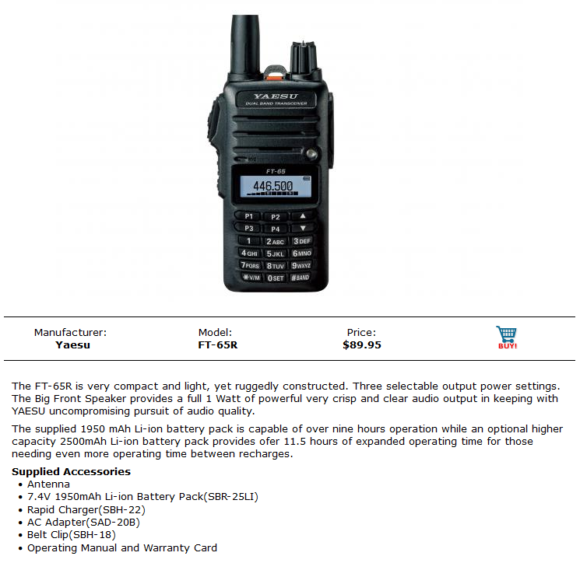
Copyright LARC 09/2022

Slide 22
LARC Recommended 2 Meter / 70 Centimeter Radios and Auxiliary Equipment
HT’s
Basic model runner up
Copyright LARC 09/2022

Slide 23
LARC Recommended 2 Meter / 70 Centimeter Radios and Auxiliary Equipment
HT’s
Basic model runner up
BaoFeng BF-F8HP
8/4/1 watts
FM broadcast receive
Be careful! Capable of transmitting outside of Ham bands
Copyright LARC 09/2022

Slide 24
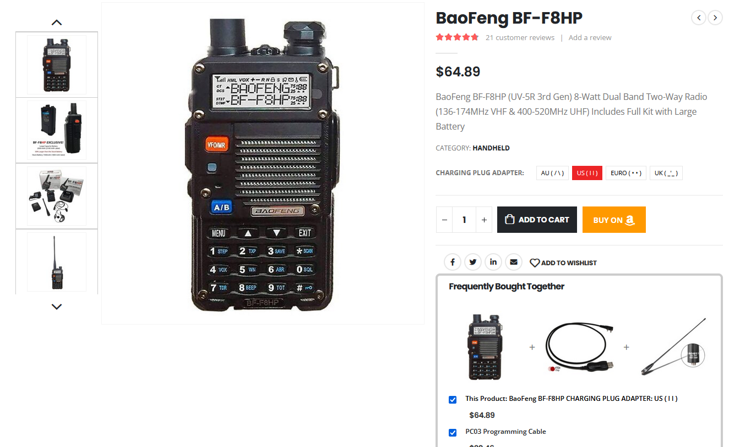
Copyright LARC 09/2022

Slide 25
LARC Recommended 2 Meter / 70 Centimeter Radios and Auxiliary Equipment
HT’s
Recommended Intermediate
BTECH DMR-6X2
Includes 2 batteries and programming cable
DMR tier 1 and tier 2
VHF 7/5/2.5/1 watts UHF 6/5/2.5/1 watts
Be careful! Capable of transmitting outside of Ham bands
Copyright LARC 09/2022

Slide 26
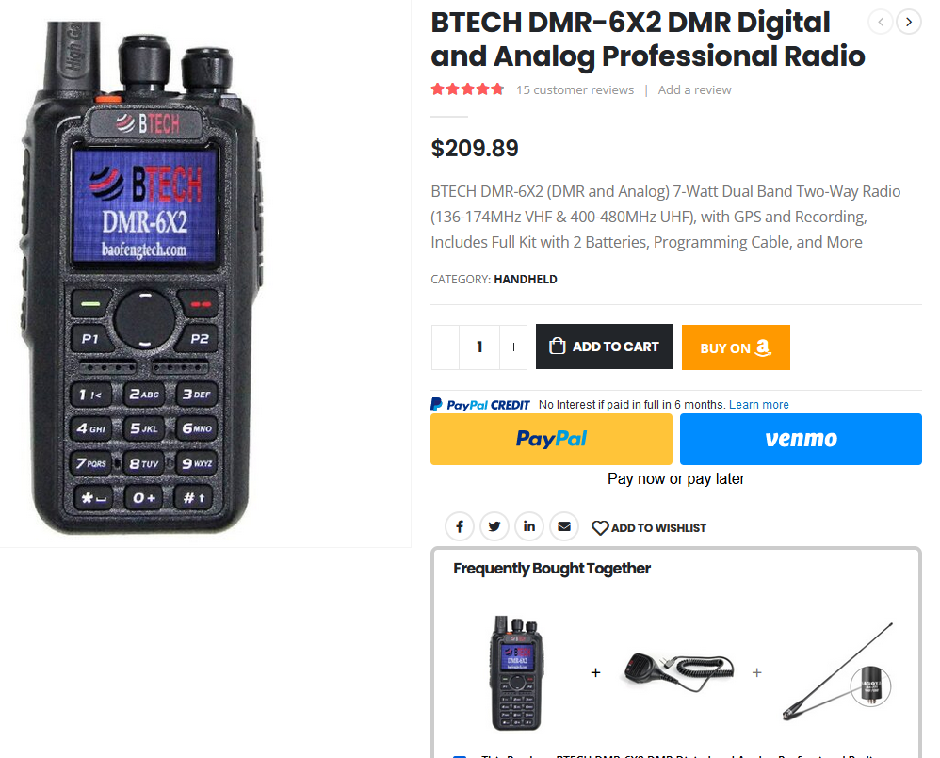
Copyright LARC 09/2022

Slide 27
LARC Recommended 2 Meter / 70 Centimeter Radios and Auxiliary Equipment
HT’s
Recommended Advanced
Anytone AT-D878UVII-Plus
APRS/GPS
DMR tier 1 and tier 2
6/4/2.5/1 Watts
Bluetooth
FCC part 90 certified
Be careful! Capable of transmitting outside of Ham bands
Copyright LARC 09/2022

Slide 28
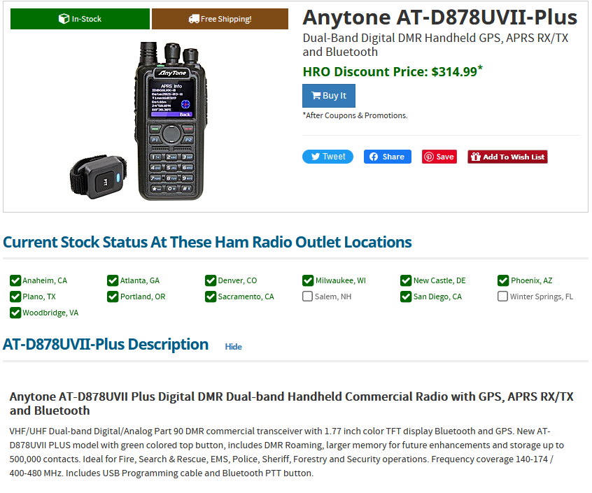
Copyright LARC 09/2022

Slide 29
LARC Recommended 2 Meter / 70 Centimeter Radios and Auxiliary Equipment
Base/Mobile Stations
All models support analog mode
Single band models not recommended but budget friendly
Yaesu FTM-3100R
65 watts
Includes programming cable and mounting bracket
Auto power off
3 year warranty
Copyright LARC 09/2022

Slide 30
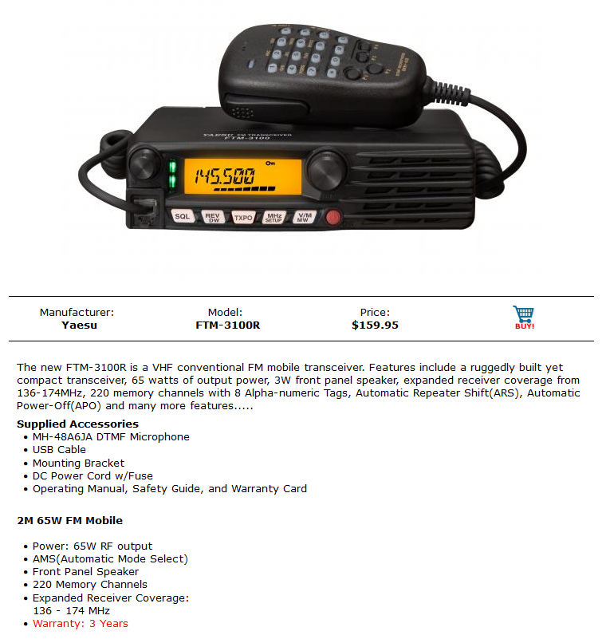
Copyright LARC 09/2022

Slide 31
LARC Recommended 2 Meter / 70 Centimeter Radios and Auxiliary Equipment
Base/Mobile Stations
All models support analog mode
Single band models not recommended but budget friendly
Yaesu FT-2980R
80 watts
Includes mounting bracket
Weather channels with alert
3 watt audio output
3 year warranty
Copyright LARC 09/2022

Slide 32
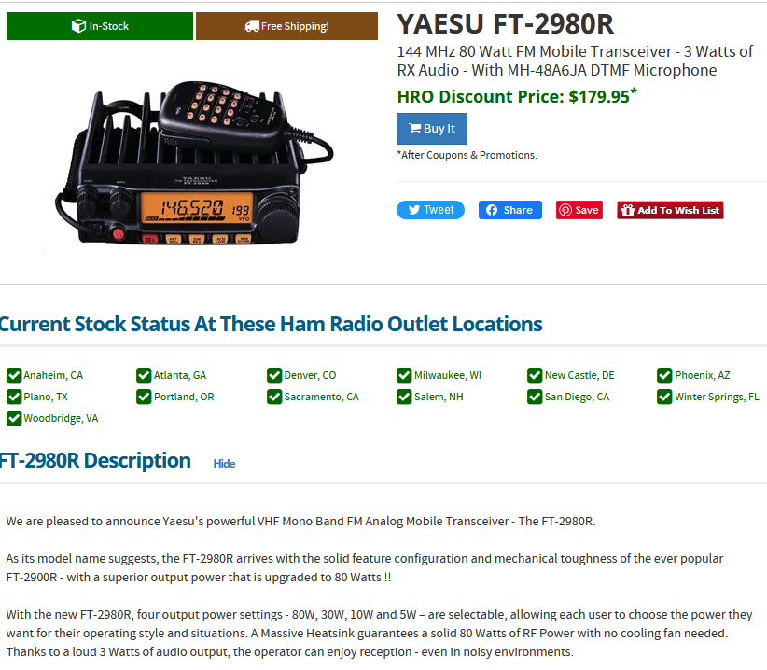
Copyright LARC 09/2022

Slide 33
LARC Recommended 2 Meter / 70 Centimeter Radios and Auxiliary Equipment
Base/Mobile Stations
All models support analog mode
Recommended dual band basic model
Copyright LARC 09/2022

Slide 34
LARC Recommended 2 Meter / 70 Centimeter Radios and Auxiliary Equipment
Base/Mobile Stations
All models support analog mode
Recommended dual band basic model
NONE
Suggestions?
Copyright LARC 09/2022

Slide 35
LARC Recommended 2 Meter / 70 Centimeter Radios and Auxiliary Equipment
Base/Mobile Stations
All models support analog mode
Recommended dual band intermediate model
Icom IC-2730A
Detachable face plate
V/V U/U simultaneous receive
Optional Bluetooth
50/15/5 watts
Copyright LARC 09/2022

Slide 36
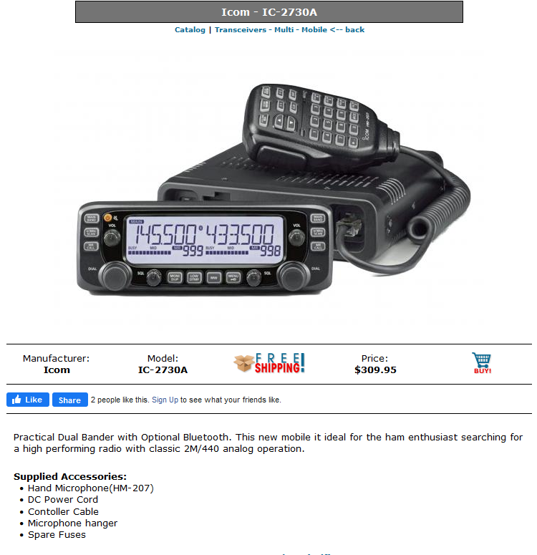
Copyright LARC 09/2022

Slide 37
LARC Recommended 2 Meter / 70 Centimeter Radios and Auxiliary Equipment
Base/Mobile Stations
All models support analog mode
Recommended dual band intermediate model
Yaesu FTM-6000R
Detachable face plate
Includes control and programming cables
Aircraft band
Optional Bluetooth
50/25/5 watts
Copyright LARC 09/2022

Slide 38
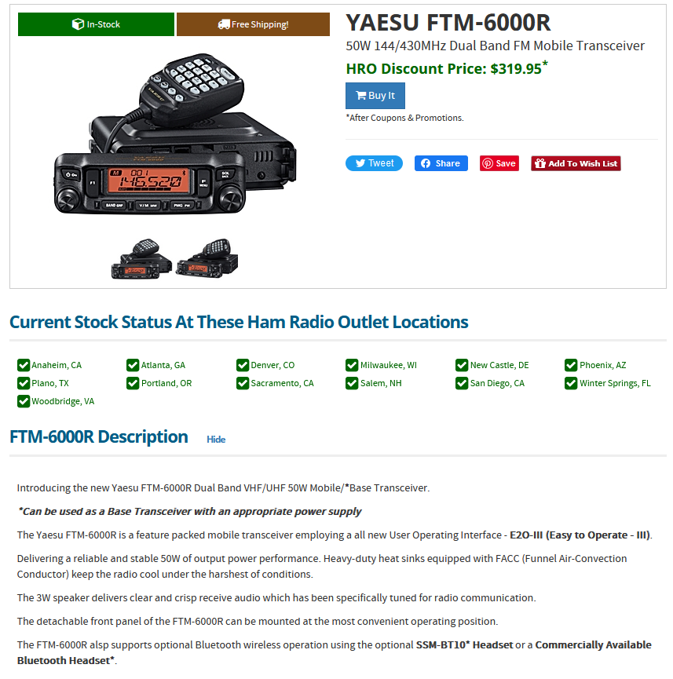
Copyright LARC 09/2022

Slide 39
LARC Recommended 2 Meter / 70 Centimeter Radios and Auxiliary Equipment
Base/Mobile Stations
All models support analog mode
Recommended tri band advanced model
Copyright LARC 09/2022

Slide 40
LARC Recommended 2 Meter / 70 Centimeter Radios and Auxiliary Equipment
Base/Mobile Stations
All models support analog mode
Recommended tri band advanced model
AnyTone AT-D578UVIII Plus
10 watts 220 mHz, 50 watts 146 mHz, 45 watt 450 mHz
Aircraft band, Bluetooth, APRS, GPS, DMR tier 1 & 2
Cross-band repeat
136-174, 220-225, 400-520 RX/TX
FCC part 90 certified
Be careful! Capable of transmitting outside of Ham bands
Copyright LARC 09/2022

Slide 41
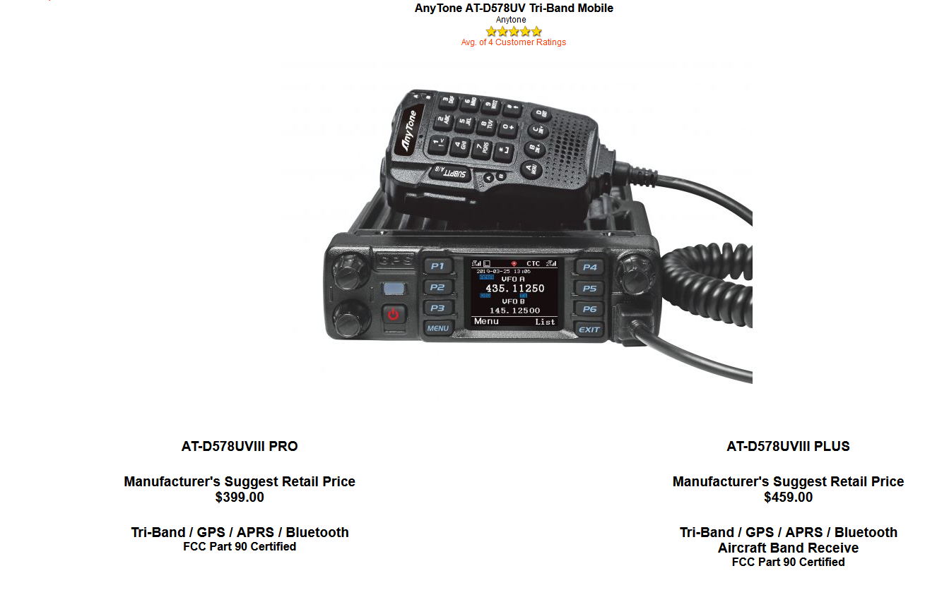
Copyright LARC 09/2022

Slide 42
LARC Recommended 2 Meter / 70 Centimeter Radios and Auxiliary Equipment
Recommended HT Antenna
Nagoya 771
Watch for fakes
Make sure the base matches
About $18.00
Copyright LARC 09/2022

Slide 43
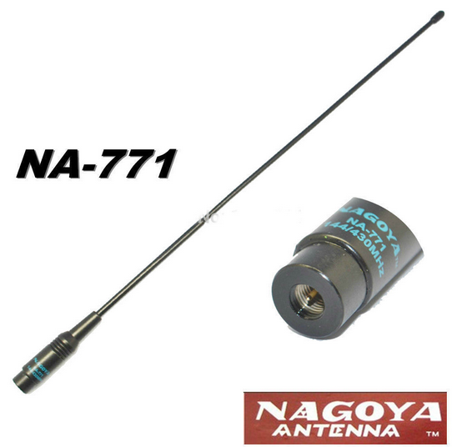
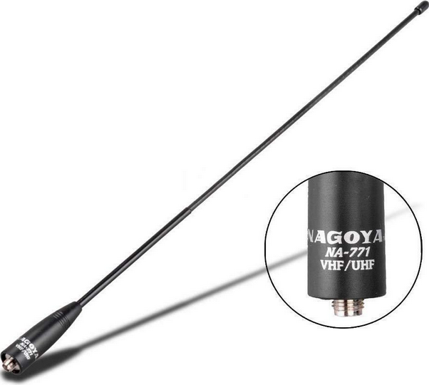
Copyright LARC 09/2022

Slide 44
LARC Recommended 2 Meter / 70 Centimeter Radios and Auxiliary Equipment
Recommended Base Antenna
Diamond X50A
200 watt power limit
Dual band
4.5 dBi gain 2 m, 7.2 dBi gain 70 cm
Copyright LARC 09/2022

Slide 45
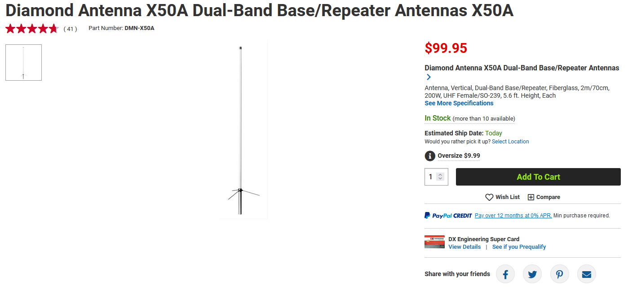
Copyright LARC 09/2022

Slide 46
LARC Recommended 2 Meter / 70 Centimeter Radios and Auxiliary Equipment
Recommended Mobile Antenna
Comet B-10 NMO
50 watt power limit
Dual band
Clears garage door when mounted on roof of vehicle
Copyright LARC 09/2022

Slide 47
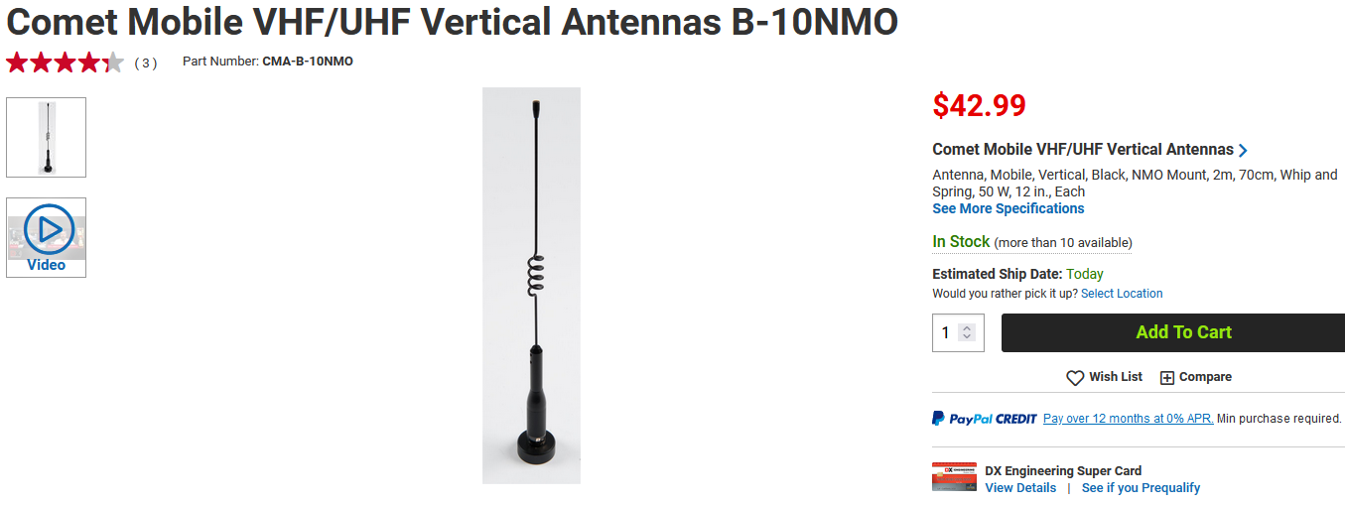
Copyright LARC 09/2022

Slide 48
LARC Recommended 2 Meter / 70 Centimeter Radios and Auxiliary Equipment
Recommended Mobile Antenna Mount
NMO
Strongest mount
Very widely used in amateur and commercial applications
Waterproof when installed correctly
Copyright LARC 09/2022

Slide 49
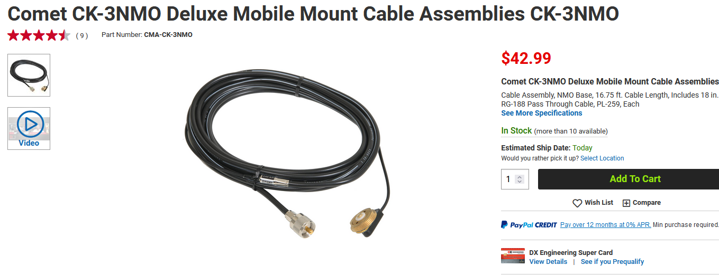
Copyright LARC 09/2022

Slide 50
LARC Recommended 2 Meter / 70 Centimeter Radios and Auxiliary Equipment
Recommended Coax
Bury-Flex
Center conductor stranded copper not CCA
Dual shield
Indoor/outdoor, direct burial
Very low loss
Low cost
Copyright LARC 09/2022

Slide 51
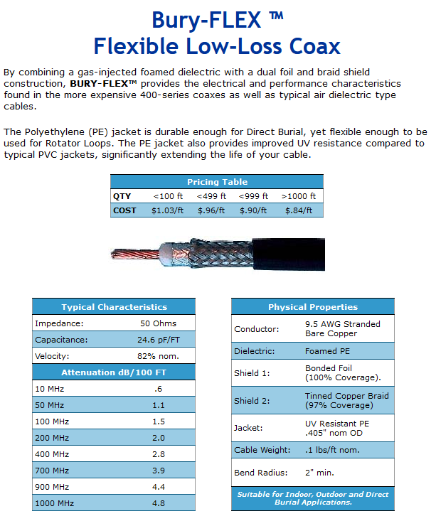
Copyright LARC 09/2022

Slide 52
LARC Recommended 2 Meter / 70 Centimeter Radios and Auxiliary Equipment
Recommended Surge Protector
Alpha Delta ATT3G50UHP
2,000 watt power rating
Replaceable gas discharge tube
Low inseration loss
Copyright LARC 09/2022

Slide 53
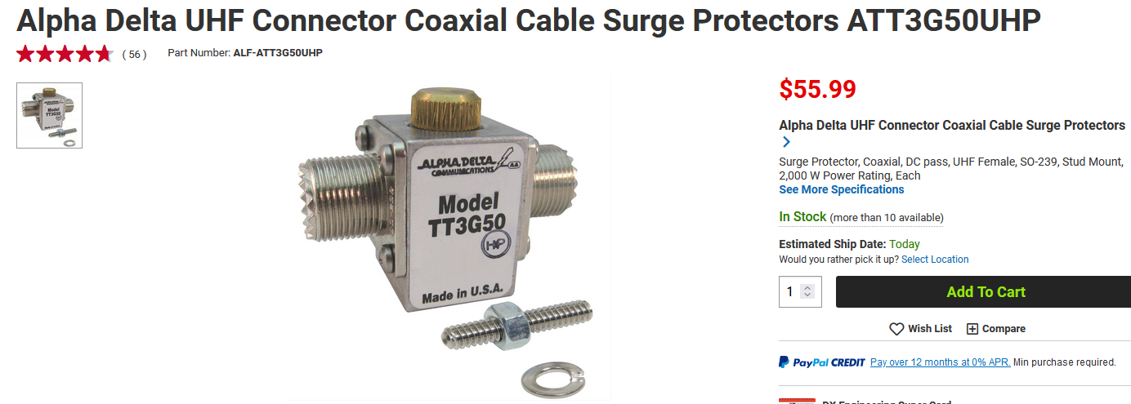
Copyright LARC 09/2022

Slide 54
LARC Recommended 2 Meter / 70 Centimeter Radios and Auxiliary Equipment
Recommended Power Supply
Samlex SEC-1235M
30 amps continuous
35 amps max
Weight 3.4 pounds
Copyright LARC 09/2022

Slide 55
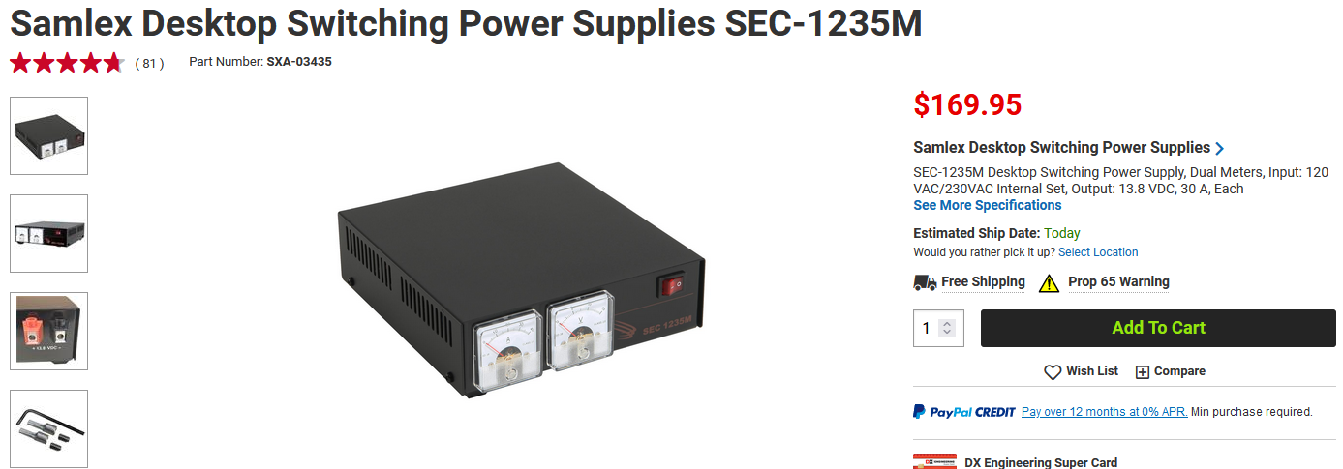
Copyright LARC 09/2022

Slide 56
LARC Recommended 2 Meter / 70 Centimeter Radios and Auxiliary Equipment
Questions/Comments
Copyright LARC 09/2022

Slide 57
Mojave desert sunset taken just North of Las Vegas, Nevada

Slide 58
Joshua trees, indicator species of the Mojave desert

