Slide 1
LARC Recommended HF Base Stations and Auxiliary Equipment
We do not recommend that you buy used equipment
Copyright LARC 09/2022

Slide 2
LARC Recommended HF Base Stations and Auxiliary Equipment
We do not recommend that you buy used equipment
We do recommend that you purchase your equipment from an established and reputable company i.e. no e-bay
Copyright LARC 09/2022

Slide 3
LARC Recommended HF Base Stations and Auxiliary Equipment
We do not recommend that you buy used equipment
We do recommend that you purchase your equipment from an established and reputable company i.e. no e-bay
This presentation does show web pages from various companies including the listed prices for equipment we are recommending. This is not meant to endorse the company, but to give you an approximation of the price you can expect pay for the given item.
Copyright LARC 09/2022

Slide 4
LARC Recommended HF Base Stations and Auxiliary Equipment
To qualify for this list items had to:
Currently be in production and available for purchase
We will not recommend any equipment that is no longer manufactured
Copyright LARC 09/2022

Slide 5
LARC Recommended HF Base Stations and Auxiliary Equipment
To qualify for this list items had to:
Currently be in production and available for purchase
We will not recommend any equipment that is no longer manufactured
Be highly rated by hams (e-ham.net)
Copyright LARC 09/2022

Slide 6
LARC Recommended HF Base Stations and Auxiliary Equipment
To qualify for this list items had to:
Currently be in production and available for purchase
We will not recommend any equipment that is no longer manufactured
Be highly rated by hams (e-ham.net)
Approved by
Bryan Leavitt W0BCL
James Nelson W0JRN
Copyright LARC 09/2022

Slide 7
LARC Recommended HF Base Stations and Auxiliary Equipment
Features
Bands
Copyright LARC 09/2022

Slide 8
LARC Recommended HF Base Stations and Auxiliary Equipment
Features
Bands
6 Meter VHF Band
10 Meter
12 Meter
15 Meter
17 Meter
20 Meter
30 Meter
40 Meter
60 Meter Very Restricted
75/80 Meter
160 Meter
Copyright LARC 09/2022

Slide 9
LARC Recommended Base Stations and Auxiliary Equipment
MODES
AM
CW
Digital
FM
FSK
SSB
Others
Copyright LARC 09/2022

Slide 10
LARC Recommended Base Stations and Auxiliary Equipment
Recommended basic model
ICOM IC-718
35 Watts AM; 100 Watts all others
Copyright LARC 09/2022

Slide 11
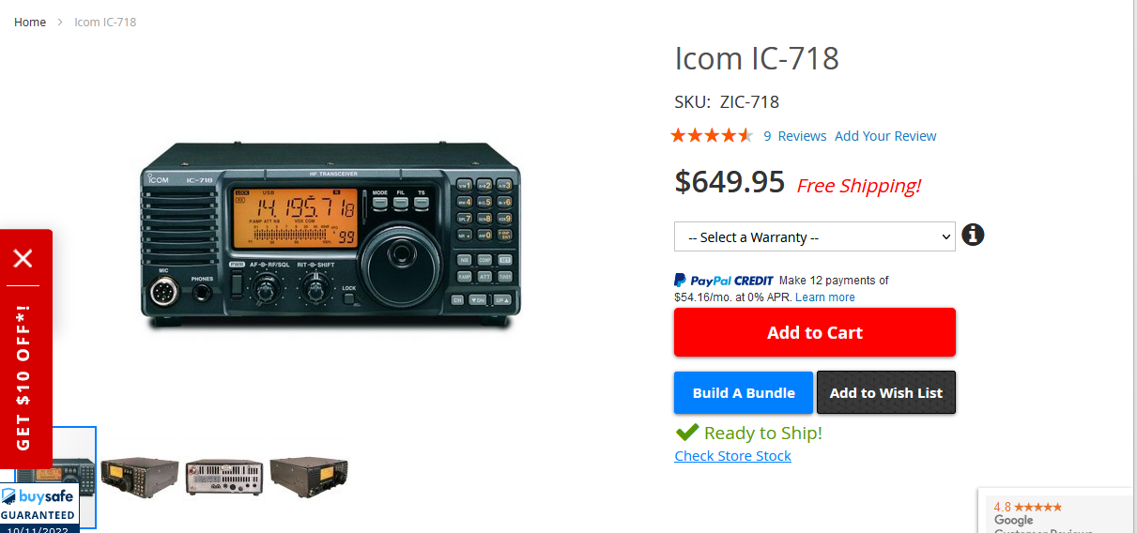
Copyright LARC 10/2022

Slide 12
LARC Recommended Base Stations and Auxiliary Equipment
Recommended Intermediate models
All have SDR Features and build in digital options
ICOM IC-7300
25 Watts AM; 100 Watts all others
YAESU FT-710 AESS
25 Watts AM; 100 Watts all others
YAESU FTDX10
25 Watts AM; 100 Watts all others
Copyright LARC 09/2022

Slide 13
Copyright LARC 10/2022

Slide 14
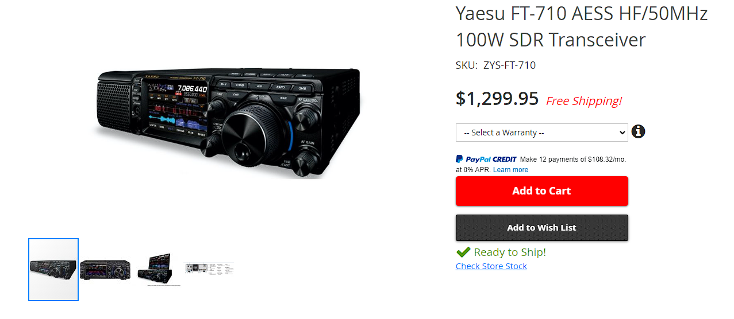
Copyright LARC 10/2022

Slide 15
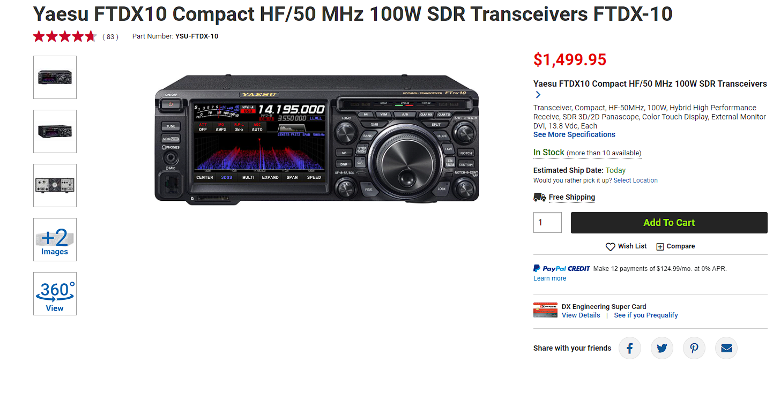
Copyright LARC 10/2022

Slide 16
LARC Recommended Base Stations and Auxiliary Equipment
Recommended Advanced model
FLEX-6700
The ultimate base station
Copyright LARC 09/2022

Slide 17
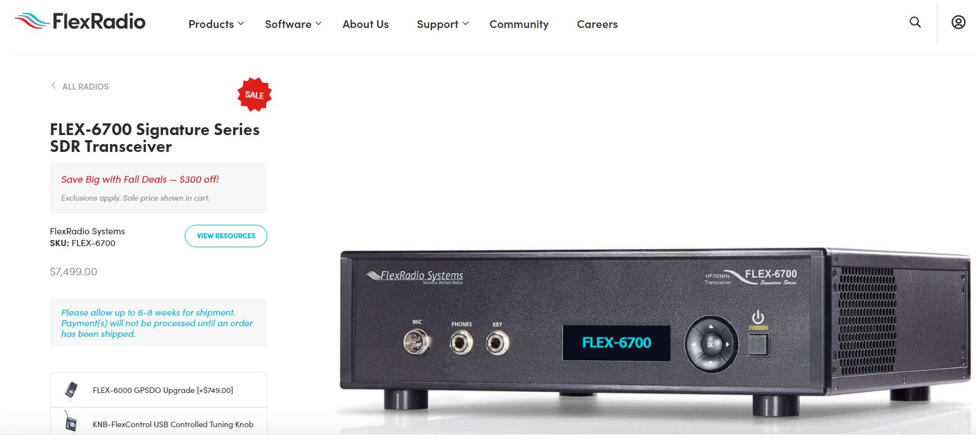
Copyright LARC 10/2022

Slide 18
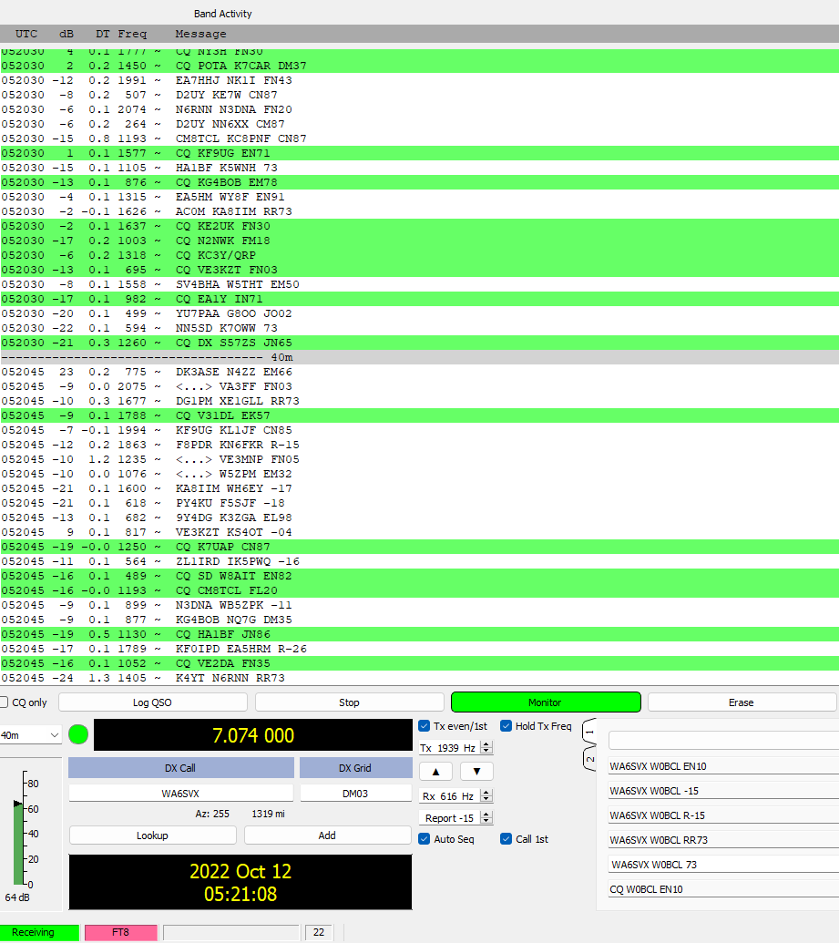
POTA – Indonesia
D2UY – Angola
CM8TCL – Cuba
HA1BF – Hungary
EA5MM – Spain
VE3KZT – Canada
SV4BHA – Greece
YU7PAA – Serbia
S57ZS – Slovenia
DK3ASE – Germany
F8PDR – France
PY4KU – Brazil
9Y4DG – Trinidad & Tobago
ZL1IRD – New Zealand
Copyright LARC 10/2022

Slide 19
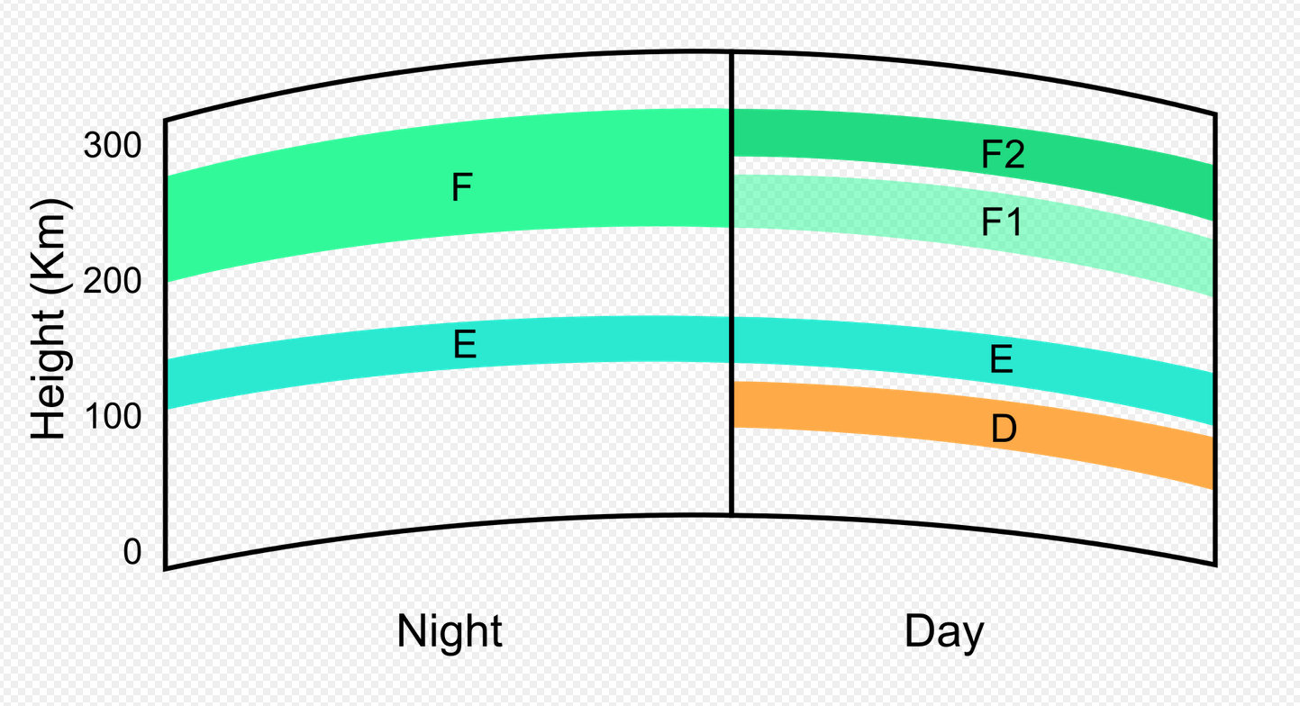
Copyright LARC 10/2022

Slide 20
Copyright LARC 10/2022

Slide 21
Copyright LARC 10/2022

Slide 22
Copyright LARC 10/2022

Slide 23
Copyright LARC 10/2022

Slide 24
Copyright LARC 10/2022

Slide 25
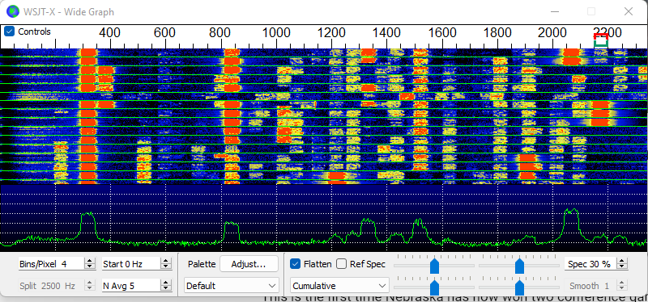
Copyright LARC 10/2022

Slide 26
Copyright LARC 10/2022

Slide 27
Copyright LARC 10/2022

Slide 28
Copyright LARC 10/2022

Slide 29
Copyright LARC 10/2022

Slide 30
Copyright LARC 10/2022

Slide 31
Copyright LARC 10/2022

Slide 32
Copyright LARC 10/2022

Slide 33
HF Antennas
Copyright LARC 10/2022

Slide 34
HF Antennas
MAKE YOUR OWN
Dipole or end fed
Copyright LARC 10/2022

Slide 35
HF Antennas
MAKE YOUR OWN
Dipole or end fed
VERTICAL
Omni Directional
Requires less space
Copyright LARC 10/2022

Slide 36
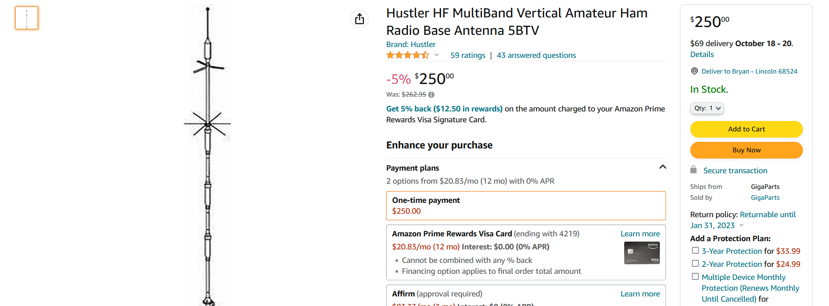
Copyright LARC 10/2022

Slide 37
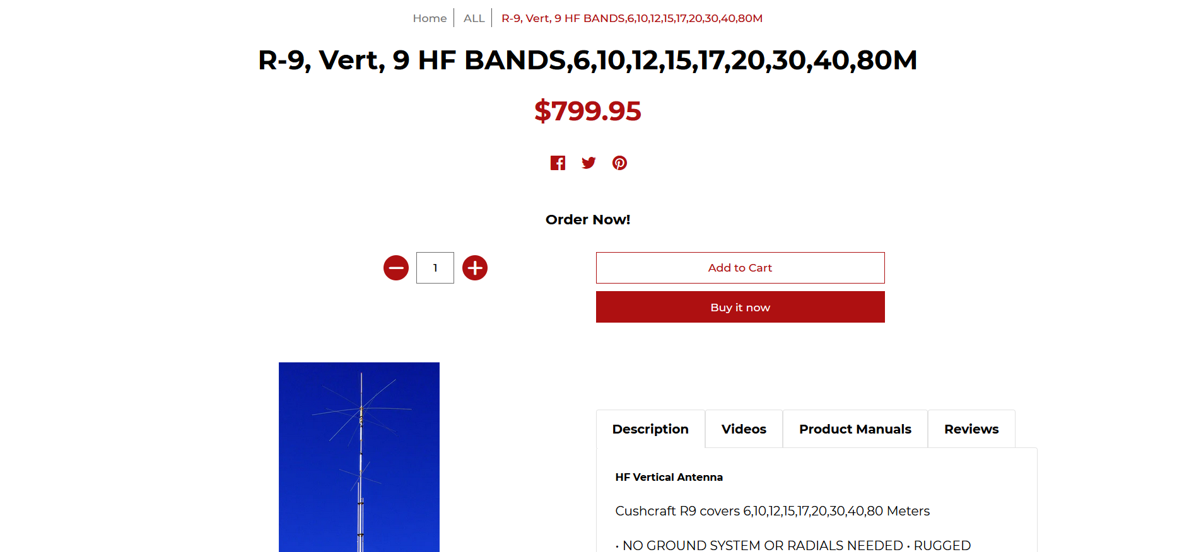
Copyright LARC 10/2022

Slide 38
Night sky – Gudmunsen Sandhills Ranch – Near Whitman, Nebraska
Copyright LARC 10/2022

